Slide 1

Diamonds on the Rocks
De Beers Case Study
BG665
March 2005
Catalyst
Rough Diamonds courtesy of De Beers Group

Slide 2
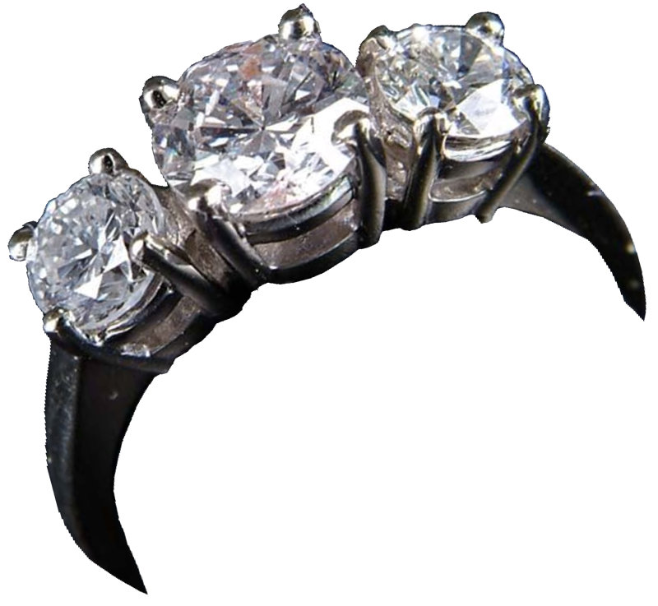
Problem Statement
De Beers
Context
Declining revenues, liquidity problems and a bloated diamond stockpile are leading to decreased profits, diminished return on equity and a dwindling cash reserve
Analysis
Plan
Today
csu catalyst 2005 • executive mba program • lambert
Ring courtesy of James D Julia

Slide 3
Troubled Times for De Beers (1983)
De Beers
Context
Saturated marketplace
Problems with public relations
Rumors of De Beers’s demise
Contract negotiations with key suppliers
Emerging suppliers from developed countries
Analysis
Plan
Today
csu catalyst 2005 • executive mba program • lambert
Ring courtesy of James D Julia

Slide 4
From Scarcity to Abundance
De Beers
Context
"The first effect of discovering kimberlites was that it converted diamonds from a rare gem to an industrial product like copper or any other product that you can mine."
Edward Jay Epstein, The Diamond Invention, 1982
Analysis
Plan
Today
csu catalyst 2005 • executive mba program • lambert
Ring courtesy of James D Julia

Slide 5
The Timing of De Beers
De Beers
Context
1880 - founded by Cecil Rhodes
1888 - controls 95% of the world’s diamonds
1893 - signs exclusive deal with the precursor to the Central Selling Organization
1933 - survives great depression and buys out the CSO
1967 - discovers large deposits in Botswana and forms Debswana
1977 - speculation begins
1982 - the bubble bursts
Analysis
Plan
Today
csu catalyst 2005 • executive mba program • lambert
Ring courtesy of James D Julia

Slide 6
From Rock to Ring
De Beers
Context
Firm
Infrastructure
Rigid control of business model. Forced relationships between De Beers businesses. World-wide mine locations and a Central Sales Organization (CSO) with minimal US presence
Analysis
Human
Resource
Management
Specialized skills and responsibilities, i.e. Internal market intelligence group
Minimum US presence due to US regulation
Support Activities
Technology
Development
Plan
Precise inventory management - location, weight, origination, and the 4 C’s
Expansive price controls and management of product value exchange
Procurement
Aggressive on creation of new inventory though exclusive purchasing agreements
Today
Margin
De Beers owns some mines
Purchases nearly all mined diamonds
Cartel
Controls distribution via lots and provides $ value grading service
Stock piles diamonds
Manages supply to distributors
CSO
Sets infrequent inventory offering dates
Limited offering locations
Market Maker
Builds personal value to manage financial value
Strong advertising
No secondary market
Up-sale is only consumer option
Primary
Activities
Inbound
Logistics
Operations
Outbound
Logistics
Marketing &
Sales
After Sales
Service
csu catalyst 2005 • executive mba program • lambert

Slide 7
A Pound of Cash
De Beers
Context
Value Contributor
Mine
CSO
Diamond Cutters
Dealers
Jewelry
Mfr
Retailers
Analysis
Plan
Cost markup percent from prior value contributor
Mine
15% Rough [1]
20% Rough [1]
10% Polished
50% Polished
100% Polished
Today
Percent consumer price allocated to value contributor
24%
3.6%
2.8%
3.0%
16.7%
50%
[1] Rough diamonds loose approximately 52% of weight during cutting and polishing
csu catalyst 2005 • executive mba program • lambert
Figures from Ghemawat Case Study

Slide 8
The Central Sales Office
De Beers
Context
Serves as gateway between producers and the rest of the diamond pipeline
Enforces relationships by minimizing benefits of defecting and punishing those that do
Is the Market Maker by stabilizing prices and enforcing market discipline
Is the original “No Haggle” pricing innovator
Dictates pricing, packaging and fulfillment
Aggregates and sorts diamonds by grade
Pursues marketing activities that benefit the entire marketplace
The perfect vehicle for De Beers to build their unique relationships
Analysis
Plan
Today
csu catalyst 2005 • executive mba program • lambert
Ring courtesy of James D Julia

Slide 9
Marketing Magic
De Beers
Context
Focused, primarily, on the jewelry market
Began calculating number of marriages worldwide and adjusting output accordingly in 1890
Reinforced the symbolism of diamonds, wealth, prestige, love and devotion
Launched 1939 “Diamonds are Forever” marketing campaign
Educated purchasers
Moved into new markets
Influenced Japanese women to wear diamond wedding rings, with 65% in 1982
Primary challenge: diamonds are not a store of value and have little intrinsic value
Analysis
Plan
Today
csu catalyst 2005 • executive mba program • lambert
Ring courtesy of James D Julia

Slide 10
Hangover
De Beers
Context
“Except for those few stones that have been permanently lost, every diamond that has been found and cut into a gem since the beginning of time still exists today. This historic inventory, which overhangs the market, is literally in the public's hands. Some hundred million women wear diamonds on their person, while millions of others keep them in safe deposit boxes or strong boxes as family heirlooms. It is conservatively estimated that the public holds more than five hundred million carats of gem diamonds in this above-the ground inventory, which is more than fifty times the number of gem diamonds produced by the diamond cartel in any given year.”
Edward Jay Epstein, The Diamond Invention
Analysis
Plan
Today
csu catalyst 2005 • executive mba program • lambert
Ring courtesy of James D Julia

Slide 11
Pieces of the Pie
De Beers
Context
Analysis
Plan
Today
De Beers owns or controls all output from
South Africa, Namibia, and Botswana
csu catalyst 2005 • executive mba program • lambert
Ring courtesy of James D Julia

Slide 12
Global Perspective
De Beers
Context
Marriage rates declining
Divorce rates rising
Economy unstable
Recession in primary jewelry markets
Civil unrest plaguing Africa
Middle East in conflict
Analysis
Plan
Today
csu catalyst 2005 • executive mba program • lambert
Ring courtesy of James D Julia

Slide 13
Analysis
Rough Diamonds courtesy of De Beers Group

Slide 14

Customers
De Beers
Context
Sightholders
  80% cut their own stones before selling
  20% mark-up on polished stones
  20% sold to independent cutters
Dealers
  10% mark-up
Jewelry Manufacturers
  50% mark-up
Retailers
  100% mark-up
Consumers
Industrial buyers
Analysis
Plan
Today
csu catalyst 2005 • executive mba program • lambert
Earnest Oppenheimer courtesy of De Beers Group

Slide 15
Eye on the Prize
De Beers
Context
Supplier
Value
Customer
Analysis
Creation
Firms Activities
Plan
Mines
CSO
Buyers
Today
Cost
Value
Pay
Appropriation
Firms Activities
Mine
CSO
Buy
csu catalyst 2005 • executive mba program • lambert

Slide 16
Five Forces Historical
De Beers
Context
Threat of New Entry: Very Attractive
+ High cost of entry
+ Cornered the market
+ Strong Brand
+ Existing mining and political relationships
+ Access to new mines
+ Owns distribution channel
+ Control of output
Analysis
Plan
Bargaining Power of Customers: Attractive
+ Only game in town
+ No substitutes for diamonds
+ Customs/tradition
+ War
+ Quality of product
- Luxury item / not necessity
-/+ Economy
Today
Threat of Substitutes: Attractive
+ No substitutes for diamonds
+ Cultural history
+ Social issues/status
+ High cost of entry
Bargaining Power of Suppliers: Very Attractive
+ Controls output
+ Owns distribution channel
+ Alliances
+ Relationships with foreign governments
+ Cash on delivery
Existing Customer Rivalry: Very Attractive
+ Strong Brand
+ Trust already built with consumers and partners
+ Historical holdings
+ Expertise
+ Control of output
+ Distribution channel
csu catalyst 2005 • executive mba program • lambert

Slide 17
Five Forces 1980s
De Beers
Context
Threat of New Entry: Mildly Attractive
+ High cost of entry
+ Cornered the market
+ Strong Brand
+ Existing mining and political relationships
+ Access to new mines
+ Owns distribution channel
+ Interest rates increase from 6% to 25 – 30%
- Zaire sells on open market
- Argyle markets its output
Analysis
Plan
Today
Threat of Substitutes: Attractive
+ No substitutes for diamonds
+ Cultural history
+ Social issues/status
+ High cost of entry
Bargaining Power of Customers: Attractive
+ Only game in town
+ No substitutes for diamonds
+ Customs/tradition
+ War
+ Quality of product
+ Increasing divorce rates
Luxury item / not necessity
Rising world interest rates
Decreasing retail demand
Decreasing marriage rates
Bargaining Power of Suppliers: Unattractive
+ Controls output
+ Owns distribution channel
+ Alliances
+ Relationships with foreign governments
- Cash is dwindling
- Zaire does not renew contract (1980)
- Argyle insists on right to market 25% of near-gem & industrial
- Sightholders decrease from over 250 to 150
- Bankrupt sightholders liquidate inventory
Existing Customer Rivalry: Very Attractive
+ Strong Brand
+ Trust already built with consumers and partners
+ Historical holdings
+ Expertise
+ Control of output
+ Distribution channel
csu catalyst 2005 • executive mba program • lambert

Slide 18
Financial Trends
De Beers
Context
Analysis
Plan
Today
csu catalyst 2005 • executive mba program • lambert
Figures from Ghemawat Case Study

Slide 19
Key Drivers
De Beers
Context
Analysis
Plan
Today
csu catalyst 2005 • executive mba program • lambert
Figures from Ghemawat Case Study

Slide 20
Substitutes and Competitors
De Beers
Context
“Doing nothing”
Other luxury items
Other gems
Imitation diamonds
Diamonds owned by consumers
Zaire: selling diamonds on the open market
Argyle mine
Analysis
Plan
Today
csu catalyst 2005 • executive mba program • lambert
Earnest Oppenheimer courtesy of De Beers Group

Slide 21
Plan
Rough Diamonds courtesy of De Beers Group

Slide 22
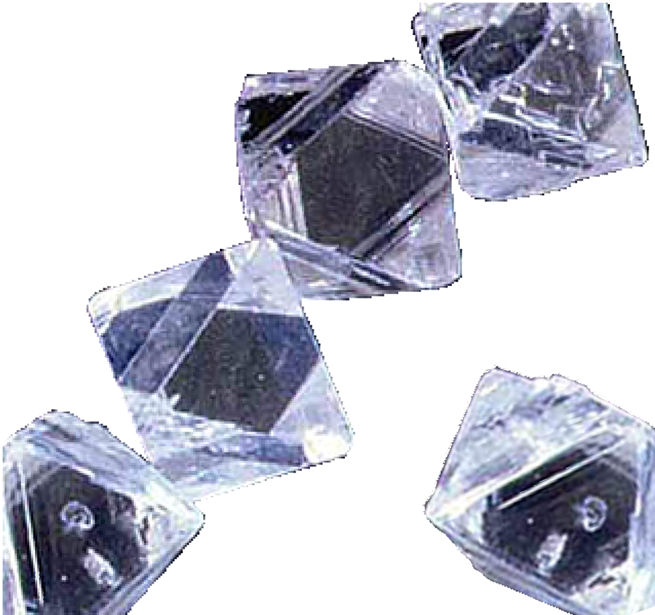
Alternatives
De Beers
Context
Establish secondary market for diamonds as investments
Liquidate smaller, lower-quality diamonds, use proceeds to purchase and hold higher quality stones
Find new sources of capital, continue to buy surplus inventory
Decrease production
Increase demand
Analysis
Plan
Today
csu catalyst 2005 • executive mba program • lambert
Rough Diamonds courtesy of De Beers Group

Slide 23
Alternative 1: Secondary Market
De Beers
Context
Pros
  Creates new demand
Cons
  No universal grading system
  Increases speculation
  Takes time to establish market
Analysis
Plan
Today
csu catalyst 2005 • executive mba program • lambert
Rough Diamonds courtesy of De Beers Group

Slide 24
Alternative 2: Liquidate Low End
De Beers
Context
Pros
  Creates much needed liquidity
  Provides Consumers an “affordable” choice
  Maximizes profit on larger, higher quality stones
Cons
  Must sell diamonds below market
  Creates imbalance in inventory
Analysis
Plan
Today
csu catalyst 2005 • executive mba program • lambert
Rough Diamonds courtesy of De Beers Group

Slide 25
Alternative 3: New Funding Sources
De Beers
Context
Pros
  De Beers can continue purchasing excess inventory
  No change in strategy necessary
Cons
  Long term debt increase
  Cost of interest
Analysis
Plan
Today
csu catalyst 2005 • executive mba program • lambert
Rough Diamonds courtesy of De Beers Group

Slide 26
Alternative 4: Decrease Production
De Beers
Context
Pros
  Decrease inventory coming into the market
  De Beers has control over 40% of production
Cons
  Others may increase production
  Adverse impact to relationship with diamond-producing countries
Analysis
Plan
Today
csu catalyst 2005 • executive mba program • lambert
Rough Diamonds courtesy of De Beers Group

Slide 27
Alternative 5: Increase Demand
De Beers
Context
Pros
  Maintain pricing
  Benefits others in supply chain
Cons
  Relatively slow process
  Advertising can be costly
Analysis
Plan
Today
csu catalyst 2005 • executive mba program • lambert
Rough Diamonds courtesy of De Beers Group

Slide 28
Recommendation: Three Components
De Beers
Context
Acquire additional financing to fund the purchase of excess inventory through the CSO
Reduce output of De Beers-controlled mines
Employ aggressive advertising strategy aimed at increasing demand
Analysis
Plan
Today
csu catalyst 2005 • executive mba program • lambert
Rough Diamonds courtesy of De Beers Group

Slide 29
Implementation Plan
De Beers
Context
Address the cash shortage - secure additional financing
Decide on operational strategy to ramp production down in company-controlled mines
Evaluate or hire advertising agency to begin working on ways to pull product through the channel more effectively
Analysis
Plan
Today
csu catalyst 2005 • executive mba program • lambert
Rough Diamonds courtesy of De Beers Group

Slide 30
Today
Rough Diamonds courtesy of De Beers Group

Slide 31

Financial Status (2004)
De Beers
Context
Turnover increase in De Beers group over 2003 of 5% - US $6.2B
Decrease in operating cash flow from US $1.58B to $985M
DTC sales reach US $5.2B
Suffering from weak US Dollar
Mining delivers 47M Carats
Analysis
Plan
Today
csu catalyst 2005 • executive mba program • lambert
Marilyn Monroe on set of Gentleman Prefer Blondes - AP

Slide 32
Supplier of Choice
De Beers
Context
De Beers is cleaning house and tightening its circle of trusted partners
De Beers restricts Sightholders to best performers and brand maintainers that are not susceptible to lowering prices
Sightholders go from 120 to 80 by 2004
DTC sales actually go up from US $5.5 to $5.7 B while restricting Sightholders
Analysis
Plan
Today
csu catalyst 2005 • executive mba program • lambert
Marilyn Monroe on set of Gentleman Prefer Blondes - AP

Slide 33
Marketing
De Beers
Context
De Beers continues its masterful marketing by creating demand; however, the campaigns are increasing in frequency and beginning to overlap compared to the clarity of their “A Diamond is Forever” campaign
The company is creating demand in its international markets with significant gains in China and India (the largest markets)
Analysis
Plan
Today
csu catalyst 2005 • executive mba program • lambert
Marilyn Monroe on set of Gentleman Prefer Blondes - AP

Slide 34
Diversification
De Beers
Context
De Beers continues to shuffle its corporate holdings, corporate brands, alliances, names and partners
Global trade zones are catching up with De Beers’s international strategy
De Beers faces increasing pressures to change business practices
Analysis
Plan
Today
csu catalyst 2005 • executive mba program • lambert
Marilyn Monroe on set of Gentleman Prefer Blondes - AP

Slide 35
International Legal Issues
De Beers
Context
De Beers settles US Department of Justice case for Industrial Diamond price fixing issues - resolves long running US disputes, likely opens market further for DeBeers in the US
Belgian diamond cutting company files suit in the EU courts against DeBeers for its Supplier of Choice program
De Beers is working toward compliance in the African programs for Black Economic Empowerment (BEE)
Conflict (Blood) diamonds
Analysis
Plan
Today
csu catalyst 2005 • executive mba program • lambert
Marilyn Monroe on set of Gentleman Prefer Blondes - AP

Slide 36
Questions
Rough Diamonds courtesy of De Beers Group

